Slide 1
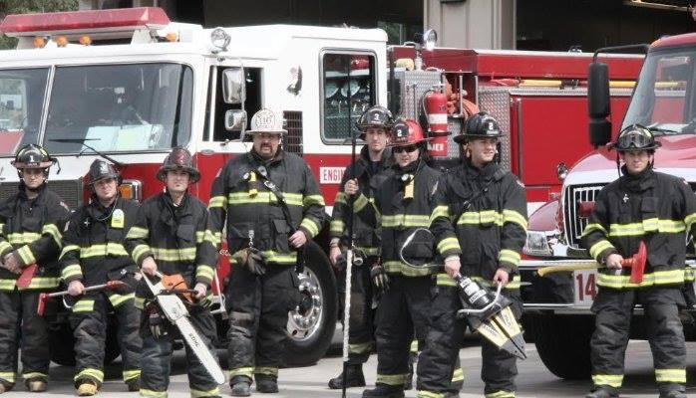
CALAVERAS CONSOLIDATED FIRE
Calaveras LAFCo Update
July 20, 2015

Slide 2




Mission
CALAVERAS CONSOLIDATED FIRE
Mission
To protect life, property and the environment through prevention, education, preparedness and emergency response
Vision
Through our commitment to innovation, service and excellence, we will always strive to be leaders in fire and life safety services, and the model of a successful fire agency

Slide 3
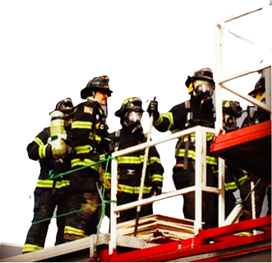
Response breakdown
 | # Incidents | % of Total
Fires | 48 | 4.31%
Rescue & EMS | 831 | 74.66%
Hazardous Conditions (No Fire) | 33 | 2.96%
Service Call | 96 | 8.63%
Good Intent Call | 49 | 4.44%
False Alarm & False Call | 45 | 4.04%
Special Incident Type | 11 | 0.99%
Total | 1113 | 100%
27.75% of our calls overlap

Slide 4


What calaveras consolidated has done
Established our mission and vision
Implemented standards (response, employment, training, administrative)
Merged 2 Fire Dist. into 1
Sold 2 Fire Stations - +$100,000/CMD Vehicle $43,000
Sold10 pieces of apparatus - + $400,000
Reduced our fire insurance rating 6 to 5

Slide 5



Programs
Fire Investigation Unit
  22 Investigations with 4 arrests
National IMT members
Chaplin
Critical Incident Stress Management Team (CISM)
Community CPR
Red Cross
CERT
Safe House/Surrender
H.S. R.O.P.
College Internship
Fire Prevention/Fire Marshal

Slide 6

Accomplishments
Staffed 2 Fire Stations 24/7/365
Purchased VS Fire Station from VSPUD
13-Firefighters have received FT offer with career agencies
4 CPR saves due to rapid response
FIU investigated over 22 fire with 4 arrests
Offered over 35 CSFM training classes
Live fire coordinator of $2.4mil statewide training grant

Slide 7
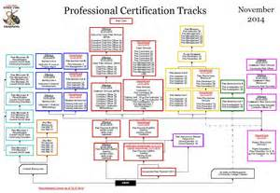
Accomplishments
8-state certified Fire Officers and 1-certified Chief Officer
Establish apparatus/facility replacement program ($500,000)
50+ volunteers on active roster (10-paramedic)
Implementation of Fire Marshal program
Supportive FF association
Update of new development impact fee program
Wine and Gold County Living – 5 Star Service Award

Slide 8
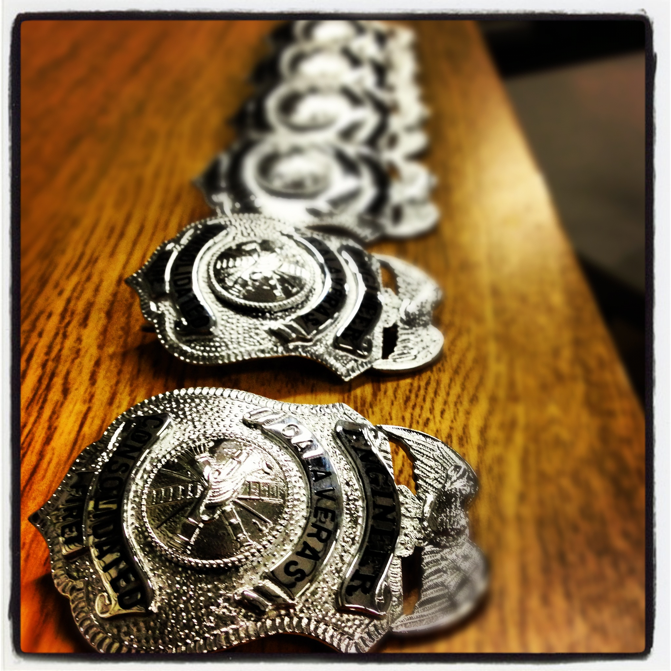
Future Needs
Secure funding for FT staffing for Jenny Lind and Valley Springs fire stations 24/7/365
Staff each fire engine with one licensed paramedic 24/7/365
Provide ambulance transport
Fire apparatus replacement
Establish special operations programs
  Water rescue, trench, confined space, USAR

Slide 9
Challenges
High turnover of volunteer/career members
Funding
Implementation of ambulance zone
Recruiting quality members
  NFPA medical physicals, background checks
Introducing CHANGE!

Slide 10
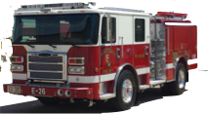
Phase 1 (2-3 yrs)
Secure funding
Apply to MVEMSA for Paramedic Authorization
Appoint M.D. as medical director for program oversight
Adopt paramedic policies
Purchase advance life support equipment
Conduct competitive employment test (residency requirement?)
Staff JL and VS fire stations 24/7/365 with FT paramedics

Slide 11

phase 2 (3-5 yrs)
Purchase ambulance
Draft mutual aid agreement with current transport provider
    Will provide back up (extend ETA or no units available)
Ask the supervisors for our own ambulance zone
Awarded our zone and provide paramedic transport!

Slide 12

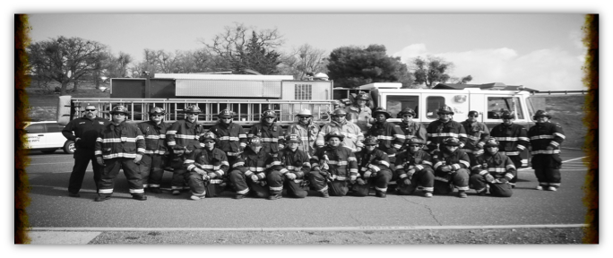
QuEstion?
www.facebook.com/CalcoFire
email me at jrobitaille@calcofire.org

