Slide 1
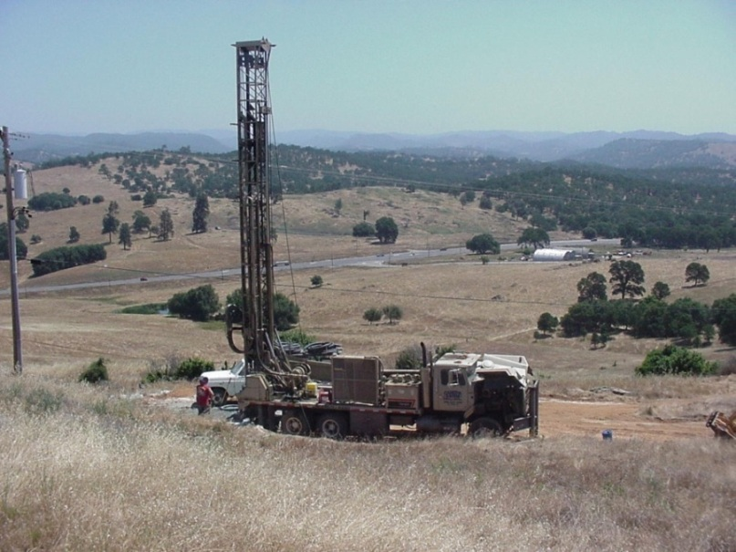
2014 Sustainable Groundwater Management Act
Environmental Management Agency
Environmental Health Department
Report to LAFCo - October 20, 2014

Slide 2
2014 Sustainable Groundwater Management Act
On September 16, 2014, Governor Brown signed a package of three bills, known as the Sustainable Groundwater Management Act.
The three bills are SB 1168 (Pavley), SB 1319 (Pavley) and AB 1739 (Dickinson).
These bills are designed to provide a framework for improved groundwater management by local agencies.

Slide 3
2014 Sustainable Groundwater Management Act
The Act provides local agencies with the tools to manage groundwater basins in a sustainable manner over the long‐term and allows for limited state intervention when necessary to protect groundwater resources. More specifically, it establishes:
a definition of sustainable groundwater management;
establishes local agencies to develop plans and implement strategies to sustainably manage groundwater resources;
prioritizes basins with the greatest problems (ranked as high and medium priority) and
sets a timeline for implementation.

Slide 4
2014 Sustainable Groundwater Management Act
January 1, 2015 – Legislation goes into effect.
June 30, 2017 – Local groundwater sustainability agencies (GSAs) must be formed.
January 31, 2020 – Groundwater sustainability plans (GSPs) must be completed for basins in a critical condition of overdraft.
January 31, 2022 – GSPs must be completed in all other high‐ and medium‐priority basins not currently in overdraft.
Twenty years after adoption of the GSP (2040 and 2042) – all high‐and medium‐priority groundwater basins must achieve sustainability.

Slide 5
2014 Sustainable Groundwater Management Act
“Sustainable groundwater management” means management and use of groundwater in a manner that can be maintained during the planning and implementation horizon without causing undesirable results.
“Undesirable results” means any of the following effects caused by groundwater conditions occurring throughout the basin:

Slide 6
2014 Sustainable Groundwater Management Act
Chronic lowering of groundwater levels, but excluding lowering of groundwater levels during a drought if it is otherwise managed;
Significant and unreasonable reductions in groundwater storage;
Significant and unreasonable seawater intrusion;
Significant and unreasonable degradation of water quality;
Significant and unreasonable land subsidence; and
Surface water depletions that have significant and unreasonable adverse impacts on beneficial uses.

Slide 7
2014 Sustainable Groundwater Management Act
Key Provisions:
Protects water rights
The legislation includes numerous provisions to protect water rights. Water Code section 10720.5(b) says that nothing in the legislation “determines or alters surface water rights or groundwater rights under common law or any provisions of law that determines or grants surface water rights.”

Slide 8
2014 Sustainable Groundwater Management Act
Key Provisions Continued:
Promotes coordinated management of an entire groundwater basin
Any local agency or combination of local agencies overlying a groundwater basin may form a Groundwater Sustainability Agency (GSA) for the basin.
In high‐and medium‐priority basins, GSAs will need to prepare Groundwater Sustainability Plans (GSPs) which can build on the regions existing groundwater plans. (http://www.water.ca.gov/groundwater/casgem/).

Slide 9
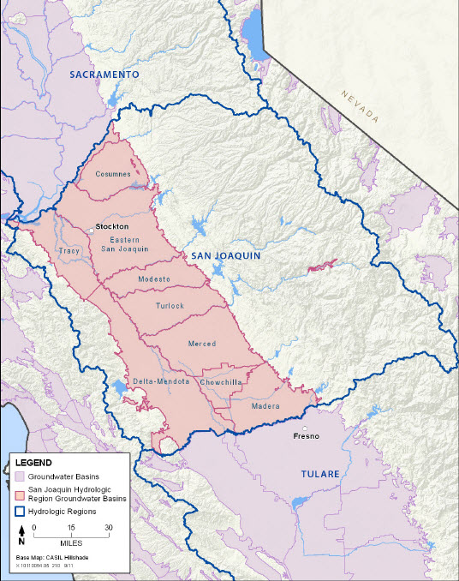
2014 Sustainable Groundwater Management Act
San Joaquin Groundwater Basin This basin is currently in a state of overdraft pursuant to DWR Bulletin 118.

Slide 10
2014 Sustainable Groundwater Management Act
The East San Joaquin
Groundwater Sub-basin
incorporates approximately
seventy square miles of
Calaveras County.

Slide 11

2014 Sustainable Groundwater Management Act
East San Joaquin Ground Water Sub-basin
A 3-dimensional view of the wells in Calaveras County reveals the differences regarding well depth and yield between the hard rock area (off-basin), where yields and depth may change drastically within few feet, and the more homogenous area where the East San Joaquin Groundwater Sub-basin reaches into the county.
Run 3D Animation

Slide 12
2014 Sustainable Groundwater Management Act
Key Provisions Continued:
Considers multiple stakeholder interests
A GSA must consider the interests of a variety of different stakeholders, including beneficial users of water, environmental interests, disadvantaged communities, tribes and others, and conduct outreach to them.

Slide 13
2014 Sustainable Groundwater Management Act
Key Provisions Continued:
Provides GSAs with new authority to responsibly manage groundwater
GSAs can choose among numerous new tools and authorities, including the authority to conduct investigations, determine the sustainable yield of a groundwater basin, measure and limit extraction, impose fees for groundwater management and enforce the terms of a groundwater sustainability plan.

Slide 14
2014 Sustainable Groundwater Management Act
Key Provisions Continued:
Respects regional differences and provides flexibility
There is a wide diversity of conditions in groundwater basins throughout the state, so the legislation provides options for development of plans and avoids a “one size fits all” approach.
Each basin can be covered by a single plan or by multiple plans and coordinated by a single coordination agreement that covers the entire basin. A region can modify the basin boundaries to suit the regional management needs.
The development and adoption of GSPs is exempt from CEQA requirements.
The California Department of Water Resources (DWR) may grant up to two 5‐year extensions if the agency demonstrates a need for the extension and has demonstrated progress toward its sustainability goal.
DWR will need to adopt regulations by June 1, 2016, regarding GSPs, coordination agreements and alternative plans and documentation.

Slide 15
2014 Sustainable Groundwater Management Act
Key Provisions Continued:
Increases availability of information but ensures privacy protection
The legislation limits the public release of all information related to individual groundwater pumpers, but provides aggregated groundwater information for a groundwater basin thus remaining consistent with existing water law.
After a GSP is adopted, a GSA will need to submit annual reports to DWR on the condition of the basin.

Slide 16
2014 Sustainable Groundwater Management Act
Key Provisions Continued:
Provides state technical and financial assistance
DWR will provide technical assistance to local agencies in the implementation of this legislation and to develop best management practices.
$100 million in grant funding is included in the pending Water Bond (Proposition 1-A) to be used for the development and implementation of groundwater management plans and projects that may include our proposal to develop a local agency groundwater management grant program! ??

Slide 17
2014 Sustainable Groundwater Management Act
Key Provisions Continued:
Offers a reasonable level of state oversight and involvement
DWR will review GSPs and their implementation.
Within two years of submission, DWR will evaluate and assess a GSP. DWR will evaluate each GSP or alternative at least every five years.
The State Water Resources Control Board (SWRCB) can only intervene in a local area and develop an interim plan in limited circumstances:
When no local agency is willing to serve as a GSA (2017);
When a GSA does not complete a GSP (2020); or
When both the GSP is inadequate or not implemented to achieve sustainability and there is a condition of long term overdraft or significant depletion of interconnected surface waters (varies 2020, 2022, or 2025).

Slide 18
2014 Sustainable Groundwater Management Act
Key Provisions Continued:
Offers a reasonable level of state oversight and involvement
SWRCB can assess fees to recover costs incurred in administering an unmanaged area or a probationary basin, which may include reporting requirements, investigations, facilitation, monitoring, hearings, enforcement and administrative costs.

Slide 19
2014 Sustainable Groundwater Management Act
Key Provisions Continued:
Increases coordination between land use planning agencies and groundwater sustainability agencies
Amends planning and zoning law to require increased coordination between land use planning agencies and groundwater sustainability agencies regarding groundwater plans and updates and modifications of General Plans.

Slide 20
2014 Sustainable Groundwater Management Act
A brief history of Calaveras County actions associated with groundwater:
June 1998 – The Board adopts Ordinance #2547 establishing Well Construction and Destruction standards.
August 16, 1999 – The Board adopts Ordinance #2589 and Ordinance #2590 adopting Proof of Groundwater pertaining to Land Development.
October 10, 2000 – The Board adopts Resolution #00-281 establishing the Local Agency Groundwater Protection Program.

Slide 21
2014 Sustainable Groundwater Management Act
January 22, 2002 – The Board adopts #2681 adopting standards regulating the extraction and transfer of groundwater – Groundwater Management Ordinance.
March 2005 – The Board adopts Ordinance #2833, Ordinance #2834 and Ordinance #2835 further defining Proof of Groundwater requirements pertaining to Land Development.
May 6, 2008 – The Board adopts Ordinance #2946 which is an updated version of the Well Construction and Destruction standards.
March 12, 2013- The Board adopts amendments to the requirements for Accessory Dwellings including Proof of Groundwater Standards.

Slide 22
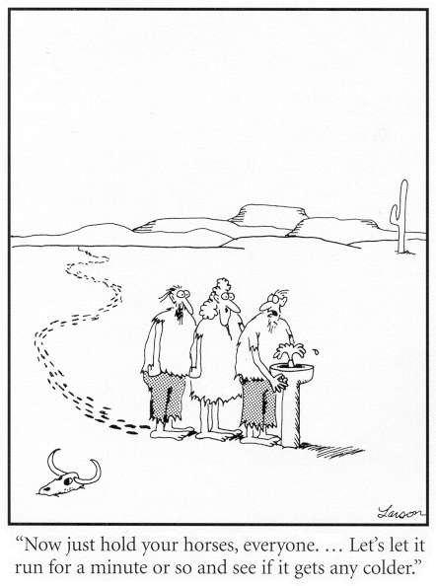
Calaveras County Groundwater Management Program
Questions

